Slide 1

Wu-Hyder Symposium Poster Template Deck
This deck contains:
Two full examples
One annotated template
One blank template
See more instructions at https://wuhyder.com/#poster
Thank you for being part of our poster session!
Hi, I’m Gemmy!
I’m Clippy’s cousin. I’m here to assist you with the poster template. I’m not part of the poster!
(Gemmy is an April Fool’s Joke from the software Obsidian, which Cathy is mildly obsessed with.)

Slide 2



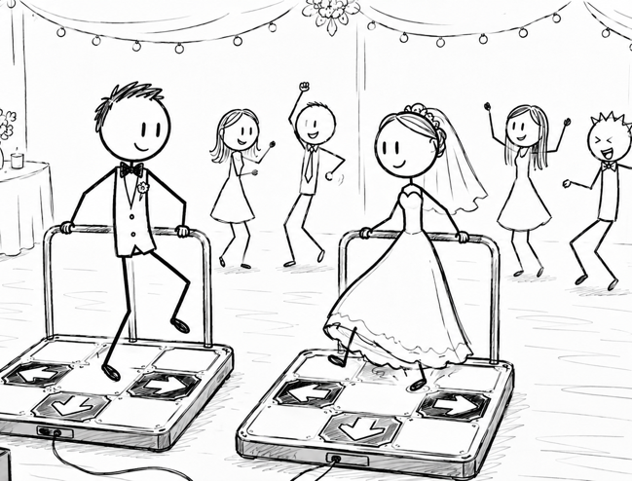
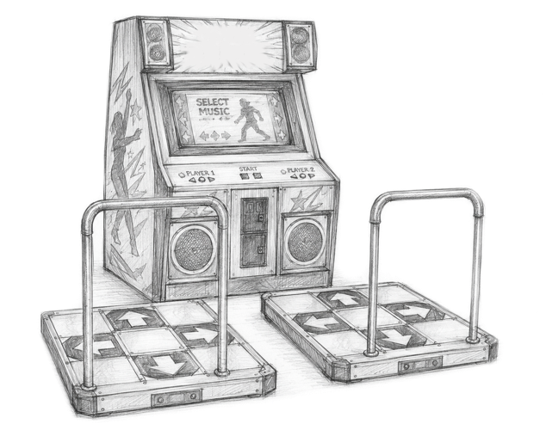
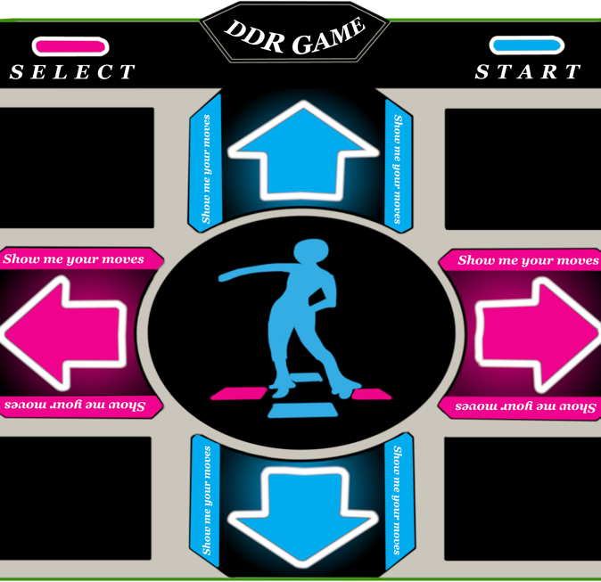
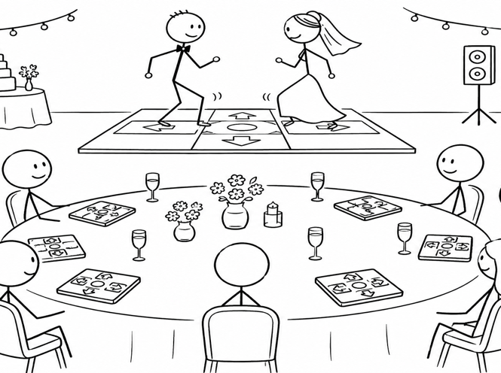
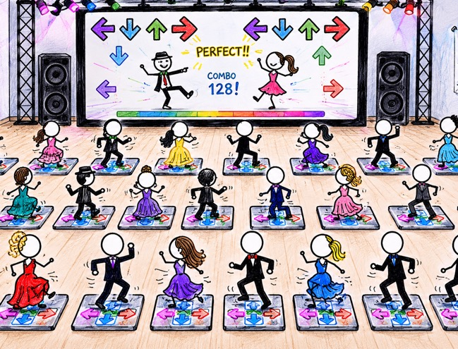

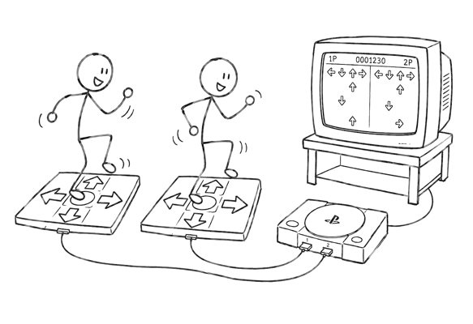
A Summary of the Wu Family's connection to "Dance"
This is a an example poster!
Meet the Author
Avid player of video games
Joseph Wu
A computer engineer by trade. Joseph lives in Seattle and likes to support independent game developers. Outside the digital realm, he cooks and tinkers.
Cathy's little brother
Joey
~2006 –
Cathy starts a DDR club in high school.
Self-evaluation
He has no experience with or ability to dance. But in DDR, he is a high-level freestyle player, even capable of playing doubles (two pads at once).
1993 –
I exist ☺
~2000 –
We first play DDR at a friend's house.
~2003 –
Nancy (older sister) sets up StepMania in our basement.
Introduction
Methods
Results
Konami released Dance Dance Revolution (DDR) in arcades around 1998. It came to gaming consoles a few years later, which is where we played it at first.
In 2022, we took advantage of Microsoft's employee fitness benefits to reimburse the purchase of solid dance pads (instead of disposable foam ones).
While planning the wedding, we considered replacing the dance with DDR.
Later on, we set up
in our basement and played DDR as a form of exercise.

Slide 3
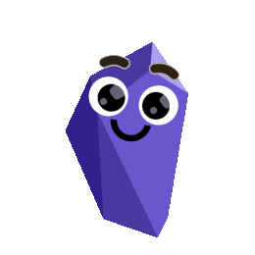



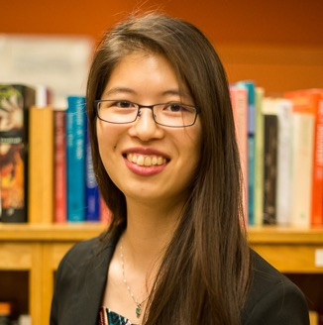
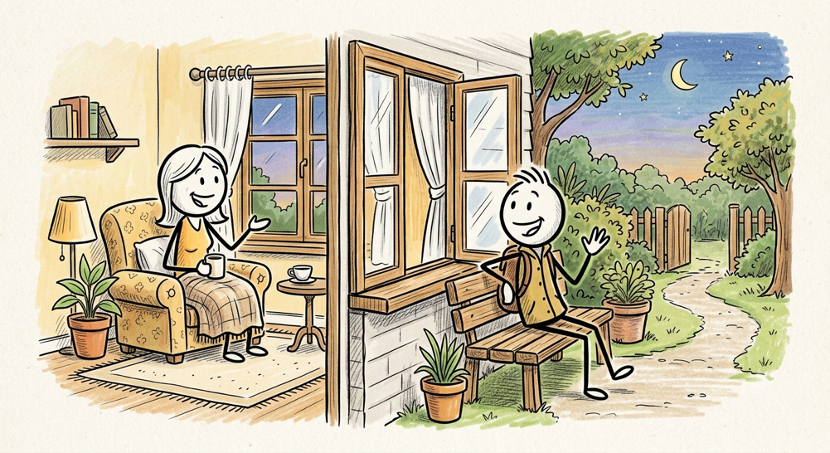
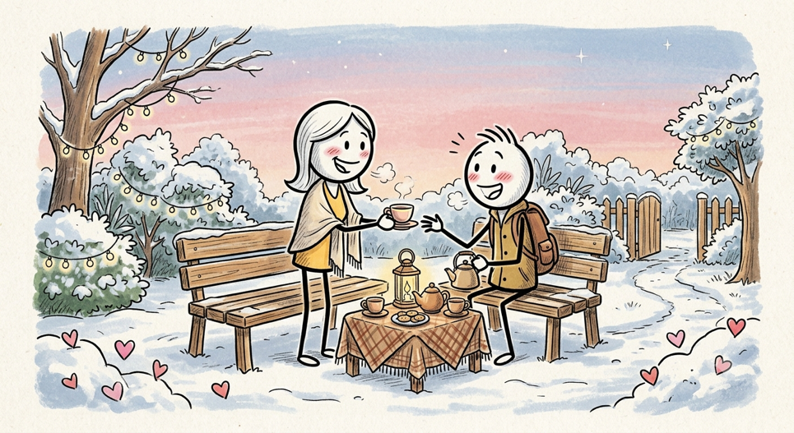
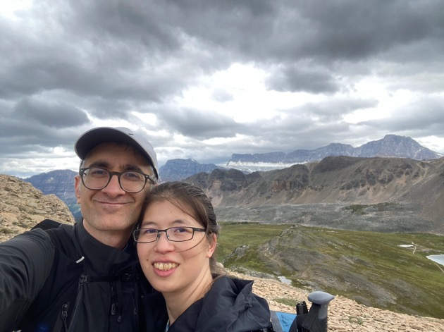
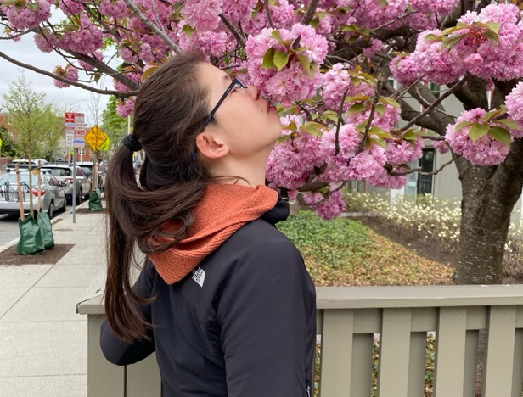
This is a second example poster!
Cathy and Omar: How It All Began
Meet the Author
Omar Hyder
The fiancé
He puts people to sleep for a living
2021 – We met!
Omar was born and raised in Pakistan which is a country in South Asia sandwiched between exotic places such as Afghanistan and India. He came to the Boston area as a student and refuses to leave.
A lover of mountains and capybaras
He likes mountains, snow sports, capybaras, rummaging through yard and estate sales, collecting tools ‘because I need it for this project’, and sometimes making stuff with aforementioned tools.
2008 - Both in Boston but didn’t meet yet!
Introduction
Methods
Results
Omar met Cathy in 2021 during the COVID-19 pandemic. Cathy didn’t want to leave the house and Omar didn’t want to stay in the house (see Bio – likes mountains).
That standoff was resolved by a backyard tea party in February, several trips to the ‘outside’ for walks and runs, and ultimately several trips in automobiles and airplanes to near and far away places including such exotic destination as Lowell, Massachusetts, the suburbs of Quebec City, Canada, and Crete.
As a result of the interactions, Omar has developed great appreciation for takeout Chinese food, nuances of 120 year old houses, and staycations.
Image below shows the results of Omar introducing Cathy to his natural habitat.
2008 - Both in Boston but didn’t meet yet!

Slide 4
Annotated poster template with instructions!
Meet the Author(s)
[You]
Use these to mark special milestones in your life or relationship with Cathy/Omar
Drag the orange lines around to indicate when you met Cathy/Omar
[Year] – [What happened that year]
Introduction
Methods
Results
The text and picture placeholders are just suggestions – feel free to customize and have fun!
Tip: use ChatGPT/Gemini to turn your ideas into cartoons
Feel free to move these boundaries around based on how much space you use for each section
The next slide is a blank template you can fill in

Slide 5
Meet the Author(s)
[You]
[Year] – [What happened that year]
Introduction
Methods
Results

